Slide 1
Ethereum vs. Bitcoin
Group 10: Wesley Fegan, Ramanand Kachhia, Alexander Lleva, Doron Griffin-Tann

Slide 2
Situation Analysis
Objective: Evaluate Ethereum as a contender of bitcoin for the basis of your currency
We will go over:
The environmental impact of each coin
How a cryptocurrency works
The profitability of each coin
The costs of cryptocurrency
Pros and Cons of Bitcoin and Ethereum
We will conclude with our recommendation and closing thoughts.

Slide 3
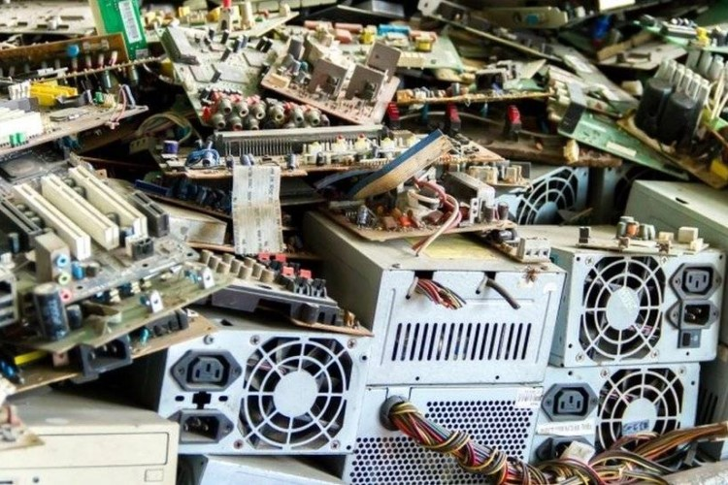
Bitcoin’s Environmental Impact: E-Wastes (E→Electronic)
Bitcoin mining produces 30 kilotons of e-waste annually
Comparable to the e-wastes of the Netherlands
Bitcoin rewards larger contributors of computing power
Incentivizes miners to upgrade their equipment for faster computing power and throw away their old equipment.
Entire computers, graphics cards, and ASIC systems—all thrown away to get newer ones.

Slide 4
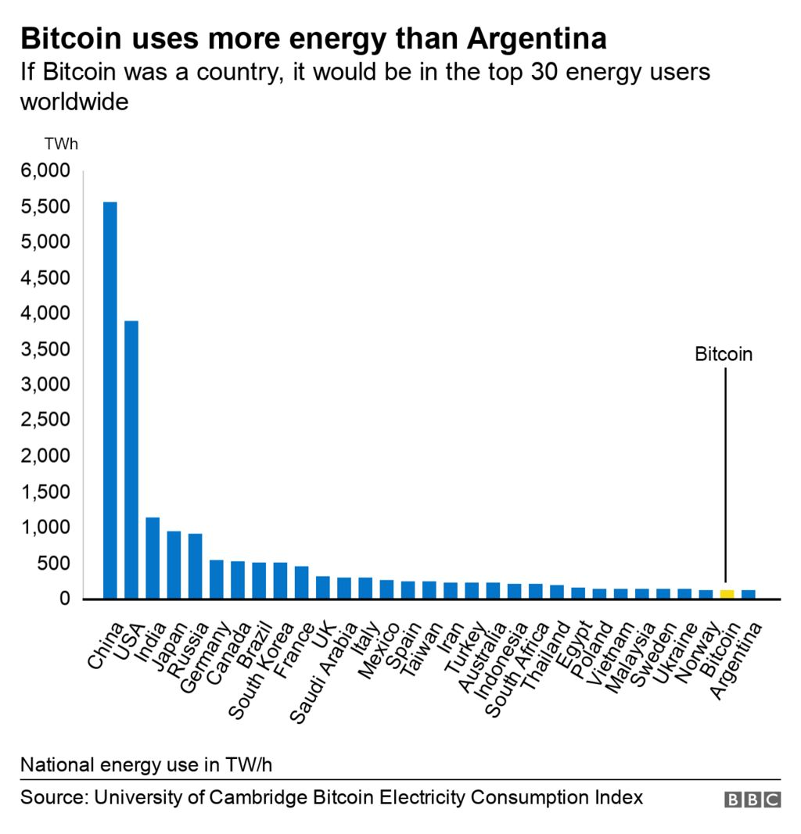
Bitcoin’s Environmental Impact: Power Consumption
Each Bitcoin transaction uses about 2100 kilowatt hours (kWh) of electricity.
Average US household consumes this in 75 days.
Annually, Bitcoin mining 91 terawatt hours of electricity.
0.5% of world’s electricity consumption
Seven times more than what Google uses annually
More energy consumed by Finland annually
Due to ASIC systems needing to run continuously and have constant cooling to prevent hardware from overheating

Slide 5

Bitcoin’s Environmental Impact: Pollution
Due to Bitcoin’s massive energy consumption, it also contributes to greenhouse gas emissions.
Annual carbon footprint is comparable to the release of 97.2 megatonnes of CO2
More annual G.G.E. than the entirety of Argentina
Damages the environment and the planet as global temperatures rise due to a continued increase in G.G.E.

Slide 6
How are Cryptocurrencies Created?
Crypto is software
Every function from how transactions are recorded to how data is stored is dictated by code
Created by algos that rely on cryptography, each transaction relates back to cryptographic code that secures the network
Decentralized and distributed
Hosted on many people's’ computer across the world instead of just one server
Algorithms are written to award coins to computers that add transactions to the blockchain by a process known as mining
Bitcoin and Ethereum use mining
Code of the cryptocurrency defines things like maximum supply, mining rewards, etc.
If new coins aren’t created by mining, they are created by other mechanisms contained in the software
Notes:
Speaker: Alex Lleva

Slide 7

Bitcoin Mining
Miners get compensated for finding a hash in new currency there are 21 million bitcoins.
Diggers will collect, exchange costs for creating another square after 21 million.
Every four years, the sum paid each hash is cut in half.
Ramanand

Slide 8

Is Bitcoin Mining Profitable?
Every four years, the award is half.
Smaller miners have found it more difficult to compete with serious miners.
Mining pools might help you be more productive, but they also come with certain drawbacks.
As of December 2019, the cost of mining one coin is about $7,000, therefore the energy expenditure alone may not be worth it.
Ramanand

Slide 9

Ethereum Mining
Ethermine has over 400,000 active miners, whereas the pool 2miners has over 80,000 active miners.
At the average hash rate, mining one Ethereum takes around 7.5 days.
Ramanand

Slide 10
Evaluating the Cost of Hardware
Wesley Fegan
The startup cost of Bitcoin and Ethereum is a serious consideration that will have an effect on the efficiency of each currency.
Typically the hardware is large upfront cost. Afterwards money is spent on electricity and maintenance.

Slide 11
The Chassis
Wesley Fegan
A chassis is the box or rack that the mining hardware is mounted in.
In the most common setup, the chassis will hold all of the standard components of a computer.
A chassis configured for GPU mining can be used for Ethereum or Bitcoin.
A seller on AliExpress sells the “B85” chassis that comes pre-configured with a motherboard capable of using up to 8 graphics cards, a 2000 Watt PSU, memory, and a processor. All for the reasonable price of $355.¹
https://www.aliexpress.com/item/1005003593023289.html

Slide 12
A Warning on ASIC Miners
Wesley Fegan
I have warned other clients about ASICS in the past. Here are my concerns:
They are very expensive.
They can only mine SHA-256 algorithm based coins such as Bitcoin and a few others.
This excludes Ethereum.
They can only be used for mining cryptocurrency and therefore may be harder to resell in the future.
They use a lot of electricity and deliver considerably lower performance compared to similarly priced GPU based setups.

Slide 13
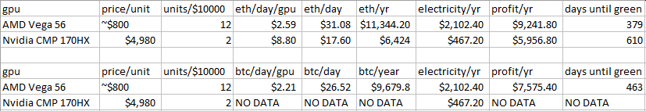
GPU-Based Mining, A Case Study
Wesley Fegan
• As of the 28th of March 2022:
1 BTC = $47,651.20 USD
1 ETH = $3,382.29 USD
• We ignore the cost of the chassis and consider an initial unit investment of $10,000 USD towards graphics cards.
• All values are in US dollars.
• The currency generated per day was taken from minerstat.com and kryptex.org.^{2, 3}
• The energy cost was determined by using the current average commercial energy rate in New Jersey: $0.12.⁶

Slide 14
Key Takeaways from the Case Study
Wesley Fegan
Many weaker cards use more electricity, but generate more profit than fewer stronger cards.
Ethereum is more profitable than Bitcoin.
Interest is waning in Bitcoin.
The very recent Nvidia CMP 170HX (which is tailored to the crypto market) does not have data available for Bitcoin.
However, there is information available for Ethereum.

Slide 15
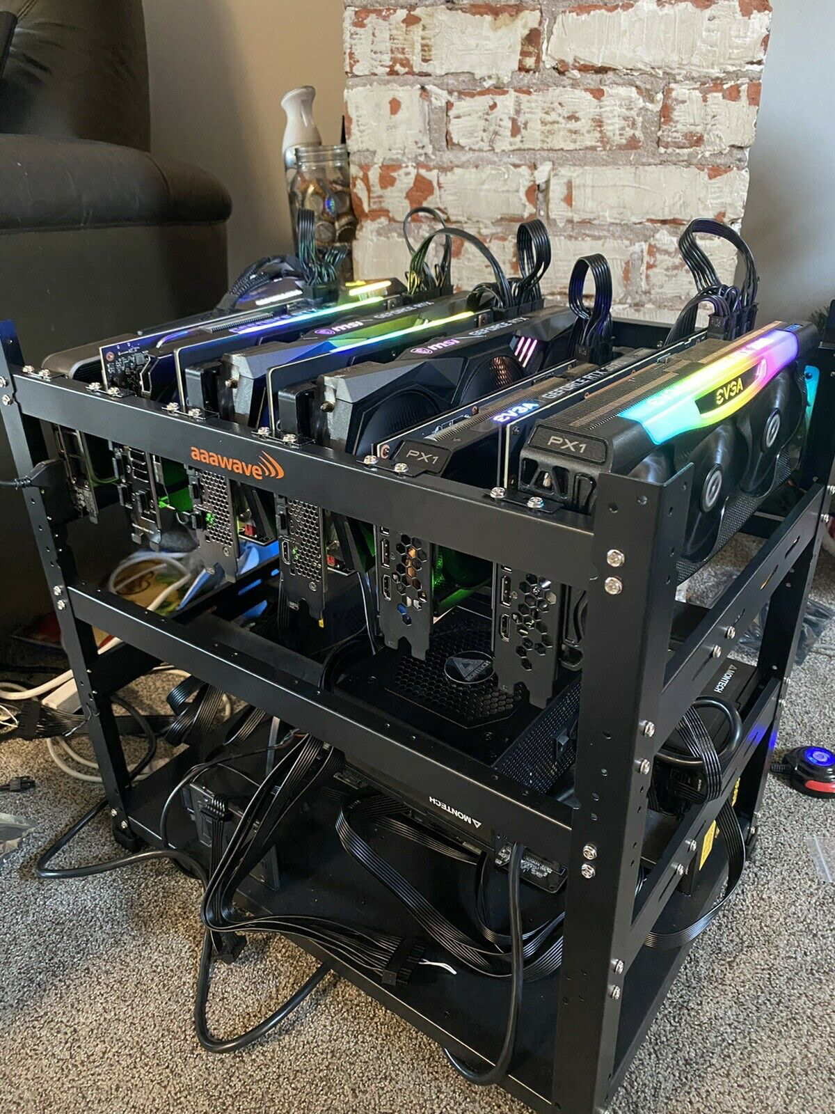
Is Ethereum Mining Profitable?
A single Ethereum miner that mined a full block was rewarded with 170 ETH ($540,000) for his efforts.
Mining Ethereum is now far more profitable than any of the other alternatives.
Mining Over the course of 2020 and early 2021, Ethereum gained considerably more money, with profits practically doubling in a single month.
Ethereum Mining Rig 550-560 MH/s “Plug and Go” 6 GPUs Source

Slide 16
Bitcoin Pros & Cons
Pro | Con
Transactions with Bitcoin don’t include banking fees. High return potential for early adopters. Accessible and liquid. Better name recognition with laymen. Transactions are P2P, pseudonymous, and transparent. Fixed number of coins may protect against inflation.⁴ | Fixed amount of Bitcoin can exist.⁴ Interest is declining. Harder to mine.
Notes:
Bitcoin Pros: Alex Lleva

Slide 17
Ethereum Pros & Cons
Pro | Con
Transactions with Ethereum don’t include banking fees. Accessible and liquid. Up to 18 million coins can be created each year.⁵ The Ethereum blockchain has room for growth. Easier to mine. | Less name recognition with laymen. May be less protected against inflation.

Slide 18
Recommendations
We recommend basing the new currency on Ethereum.
Both systems consume considerable energy, however Ethereum’s lack of ASIC support results in a considerable reduction in e-waste.
If future growth and blockchain use is important, Ethereum is better suited.
Ethereum is more popular due to its friendliness to late adopters and ease of use.
If inflation is a concern we recommend Bitcoin.
Overall, we find more evidence in support of Ethereum.

Slide 19
References
¹https://www.aliexpress.com/item/1005003593023289.html
²https://minerstat.com
³https://kryptex.org
⁴https://www.investopedia.com/articles/forex/051115/bitcoin-mining-still-profitable.asp
⁵https://www.investopedia.com/news/why-ethereum-cofounder-proposing-hard-cap/
⁶https://www.energybot.com/electricity-rates/new-jersey/
⁷https://cryptocurrencyfacts.com/how-is-cryptocurrency-created/
⁸https://roboticsandautomationnews.com/2021/12/14/what-are-the-main-benefits-of-bitcoin-get-all-the-essentials/47642/
⁹https://mint.intuit.com/blog/investments/pros-and-cons-of-bitcoin/
¹⁰https://www.sciencedirect.com/science/article/pii/S0921344921005103?via%3Dihub
¹¹https://www.fairplanet.org/story/is-cryptocurrency-bad-for-the-environment/
¹²https://www.pcmag.com/how-to/what-is-the-environmental-impact-of-cryptocurrency

